Slide 1


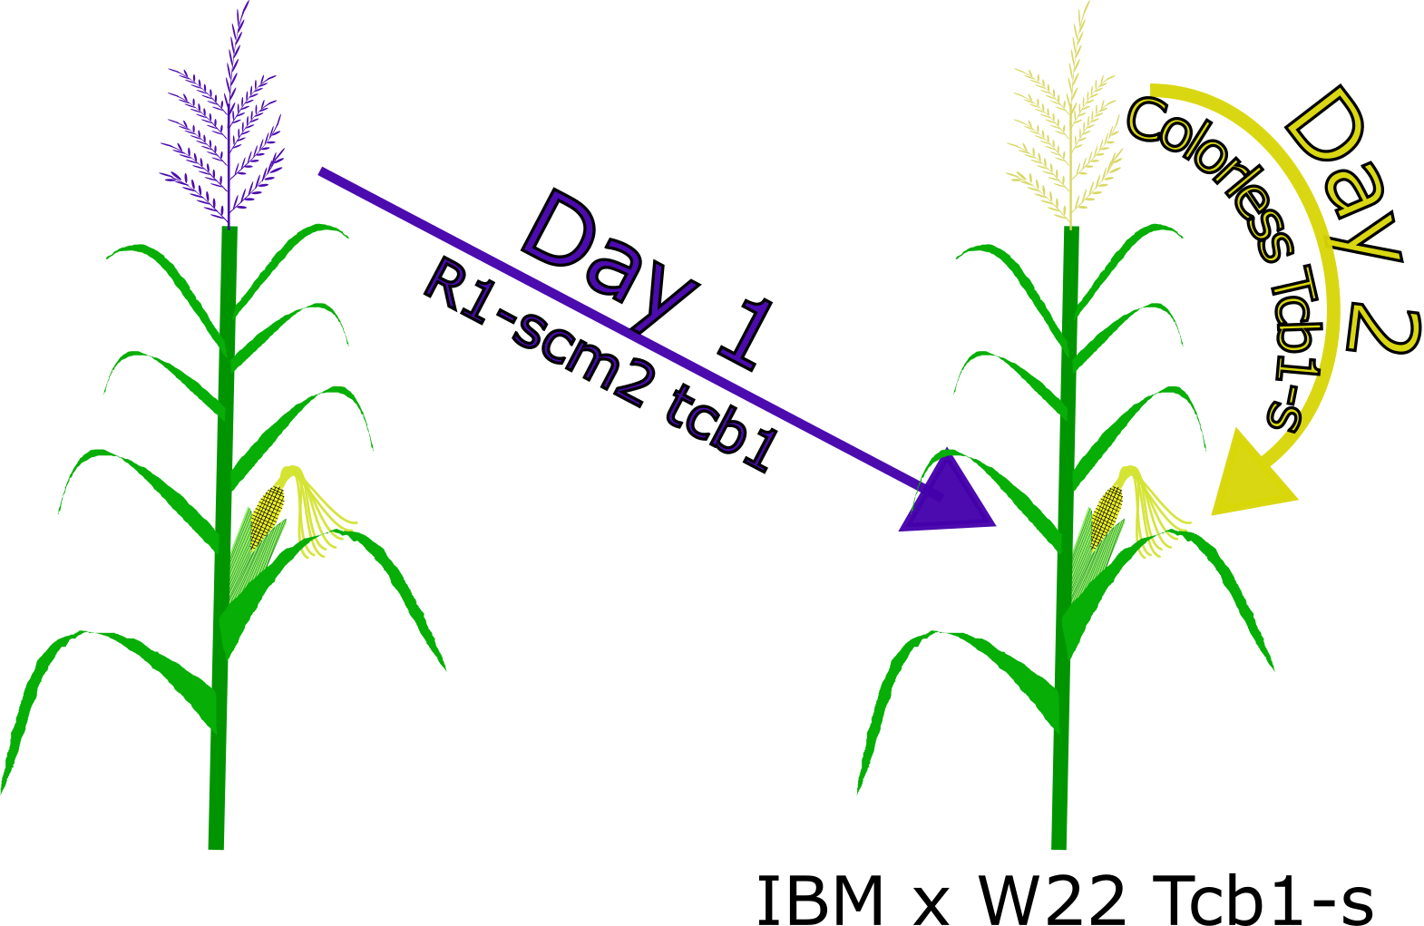
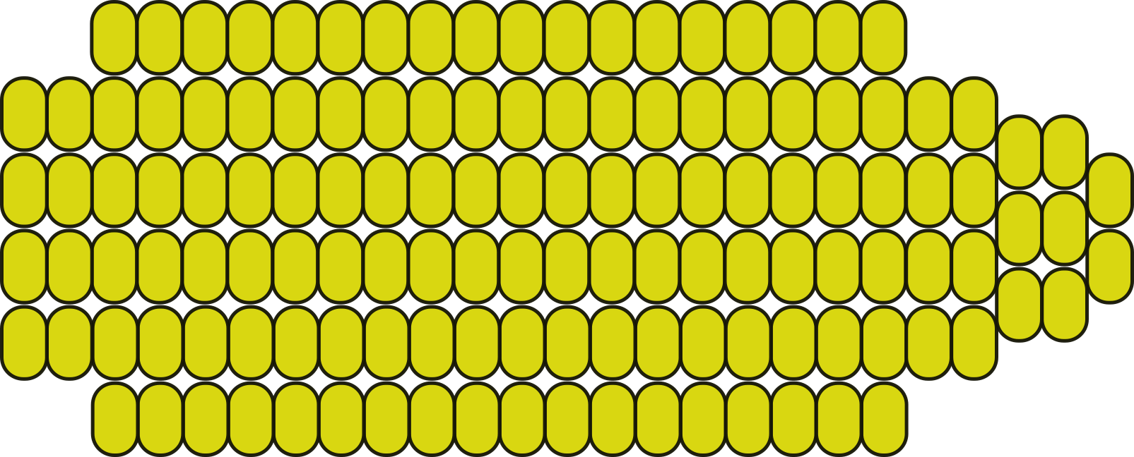
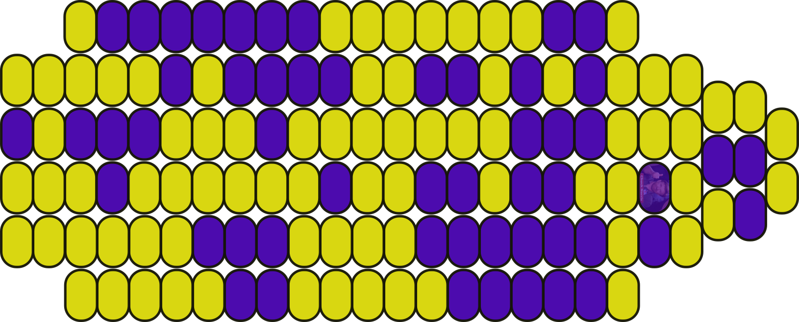
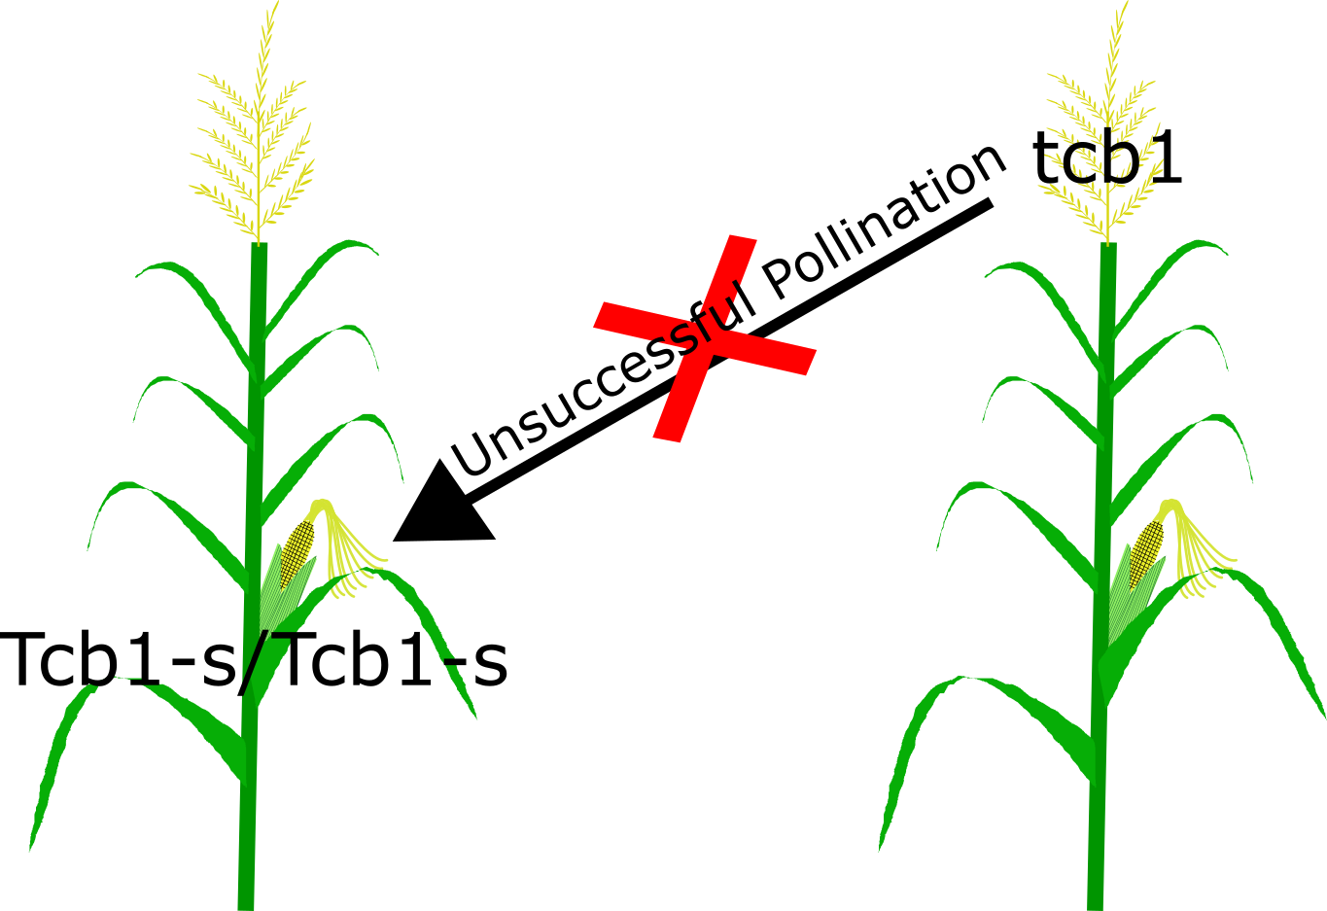
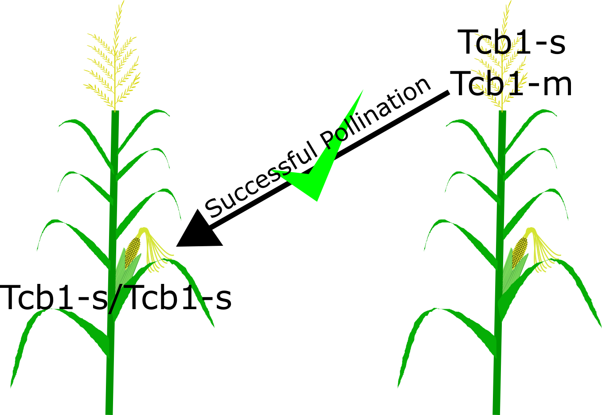
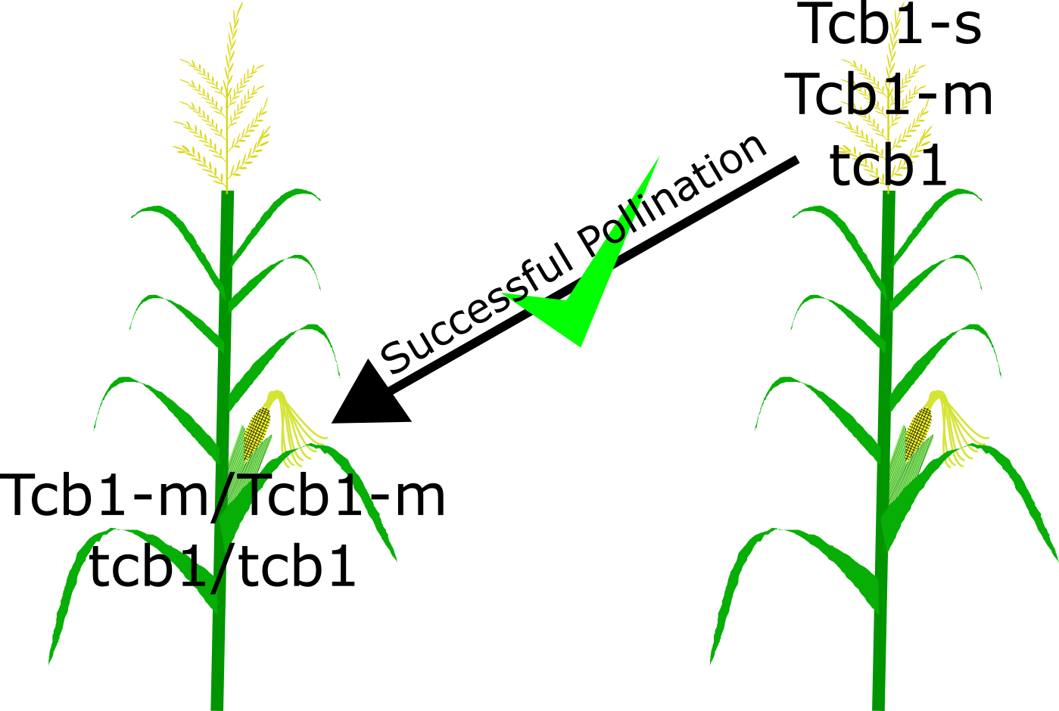

THE HUNT FOR MODIFIERS OF THE Tcb1 LOCUS
Merritt B. Burch and Donald Auger
Department of Biology and Microbiology, South Dakota State University, Brookings SD 57006, USA
Introduction & Background
Materials and Methods
Windborne contamination of organic maize by genetically modified pollen can decrease profits. Currently, farmers place barrier crops, separate fields, or displace planting times to prevent cross contamination
An easier alternative would be to introgress one of three gametophyte cross incompatibility (CI) systems: Gametophyte factor 1 (Ga1), Gametophyte factor 2 (Ga2), or Teosinte crossing barrier 1 (Tcb1)
Tcb1 was originally found in teosinte (Zea mays spp. Mexicana) and prevents fertilization from pollen with incompatible alleles (tcb1)
Tcb1 has three alleles: strong allele (-s), male allele (-m), and a null allele (Fig 1)
F1’s of many maize inbreds (e.g. B73) x W22 Tcb1-s show high incompatibility with tcb1; Mo17 x W22 Tcb1-s shows a weakened incompatibility
Using an Intermated B73 x Mo17 (IBM) recombinant inbred line (RIL) containing extensive SNP markers will help to fine map QTL of potential Tcb1 modifiers
Fig 2: Pollination of IBM Tcb1-s silks with colored R1-scm2 tcb1 pollen on day one (to test IBM x W22 Tcb1-s efficiency) and self-pollination with colorless Tcb1-s on day two
Fig 3: Predicted ear phenotypes of Fig 2 crosses. A: Strong effect of IBM x W22 Tcb1-s silks at rejecting colored tcb1 pollen. B: Weak effect of IBM x W22 Tcb1-s silks at rejecting colored tcb1 pollen
A
B
Preform experiment in summer 2017 in Brookings, South Dakota
Five plants from each IBM RIL will be crossed with R1-scm2 tcb1 pollen and colorless self Tcb1-s pollen
After harvest each RIL will be scored for the degree of tcb1 contamination
IBM contamination data will be associated with RIL markers to determine if QTL for Tcb1 modifiers are present
A
B
Expected Results
Fig 1: Teosinte crossing barrier 1 (Tcb1) cross incompatibility system. A: Unsuccessful pollination between Tcb1-s silks and tcb1 pollen. B: Successful pollination between Tcb1-s silks and Tcb1-s OR Tcb1-m pollen. C: Successful pollination between Tcb1-m or tcb1 silks and Tcb1-s, Tcb1-m, OR tcb1 pollen
Find QTL that cause tcb1 to have lower efficacy in Mo17 F1s and identify those regions of the maize genome that support tcb1 activity
Future Work
C
Isolate and sequence candidate genes to shed light on Tcb1 incompatibility
Quantify pollen tube growth in compatible and incompatible silks
Objectives
Acknowledgements & References
Find QTL from Tcb1 modifying loci
From discovered QTL regions identify and isolate candidate genes
Determine the molecular mechanism is for Tcb1 cross incompatibility
Evans, M. M. S., & Kermicle, J. L. (2001). Teosinte crossing barrier1 , a locus governing hybridization of teosinte with maize. Theoretical and Applied Genetics, 103(2-3), 259-265. doi:10.1007/s001220100549
Kermicle, J. L., & Allen, J. P. (1990). Cross-incompatibility between maize and teosinte. Maydica, 35(4), 399-408.
Kermicle, J. L., & Evans, M. M. S. (2005). Pollen–pistil barriers to crossing in maize and teosinte result from incongruity rather than active rejection. Sexual Plant Reproduction, 18(4), 187-194. doi:10.1007/s00497-005-0012-2
Lu, Y., Kermicle, J. L., & Evans, M. M. (2014). Genetic and cellular analysis of cross-incompatibility in Zea mays. Plant Reproduction, 27(1), 19-29. doi:10.1007/s00497-013-0236-5

